Slide 1

SC1015
Mini Project
Predictive Modelling
with Economic Indicators
SC14 - Group 1
Kai Seong, Julian, Horstann
Notes:
Hello my dear friends. We are Group 1 from SC14 and I will be giving you a run through of our group’s mini project, which is “Predictive Modelling with Economic Indicators”.
#####################
1) Sample Collection [FRED] / Practical Motivation [hype towards ML, explore and see if predictive models are really that good]
2) Data Preparation [LSTM & its accuracy and df_full] / Problem Formulation [Determine whether accuracy of traditional prediction model is reliable ie. can it sustain profits]
3) Exploratory Analysis / Statistical Description [time series graph, heatmap of correlations]
4) Analytic Visualization [de-trend] / Pattern Recognition
5) Algorithmic Optimisation / Machine Learning [Polynomial Regression]
6) Info Presentation / Statistical Inference [Compare & Contrast]
7) Ethical Consideration / Intelligent Decision [Past is not an indication of the future, put more importance on understanding economic situations and market sentiment]

Slide 2

02
Practical
Motivation
hype towards ML
explore predictive models
Notes:
First, allow me to explain a bit about the practical motivation of our project. So, I’m pretty sure most of you are aware that in recent years there is this huge hype towards AI and Machine Learning. Today, AI and Machine Learning can be seen in almost any field. In the field of Economics and Finance, complex predictive models are commonly used to predict portfolio performance, whereas many financial firms and organisations rely on these models for risk management and profit maximisation. With this information in mind, our project’s practical motivation is to explore these predictive models and see if they are as good as they seem to be.
#####################
recently, hype towards ML
Current state of the art:
- extremely complex predictive models (e.g. LSTM) are popularly used to predict stock prices
- many financial firms and organisations rely on these models for risk management and profit maximisation
explore predictive models, are they as good as they seem to be?

Slide 3
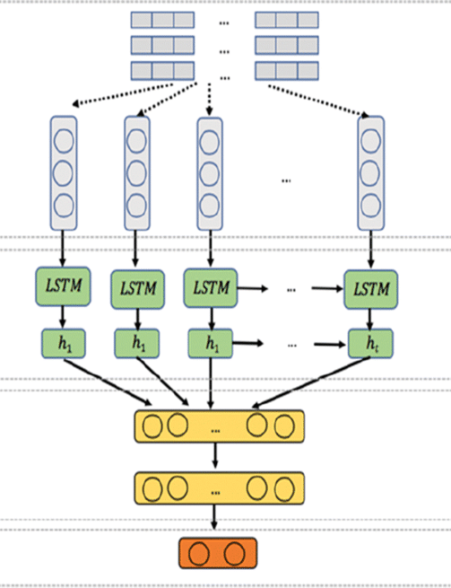
03
Problem
Formulation
How reliable are popular prediction models?
Can we make better predictions?
Notes:
For this project, we will be selecting a popular model for predicting stock market prices, called Long Short-Term Memory or LSTM for short, as our predictive model to study. What makes LSTM popular would be the fact that it can predict future values based on previous, sequential data. This brings us to our problem formulation: Is the LSTM model truly reliable? Does it have any weakness? More importantly, can we produce more reliable predictions using alternative models?
#####################
Are these models (in out case, we'll be looking at LSTM - a popular ... briefly explain) really reliable? Do they have any weaknesses?
Can we produce more reliable predictions using alternative models (in our project we explore multiple polynomial regression)?

Slide 4
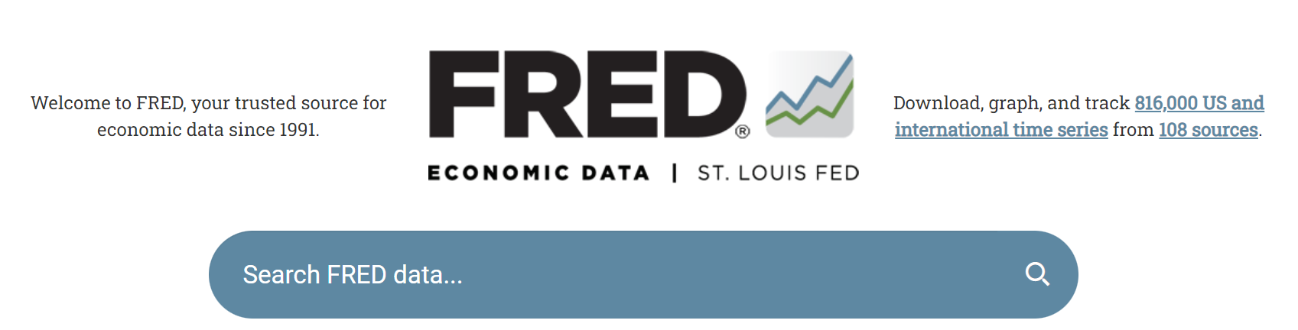
04
Sample
Collection
Notes:
To begin our project, we brainstormed about what other predictors, apart from past historical trends, greatly influence future stock market prices. We came to the hypothesis that these prices are most greatly influenced by the economic situation and sentiment of a country, and the thing that would best capture these are none other than economic indicators. So, we collected data of 13 US economic indicators, from the FRED Economic Dataset via an API key. This is a database maintained by the Federal Reserve Bank of St. Louis. Besides that, we also gained S&P500 ETF data from the Stooq website. We believed the S&P500 would be a good response variable, as it is most representative of the US economic situation and sentiment.
#####################
mention applying for a key, requesting data from the API and combine them in df_full

Slide 5
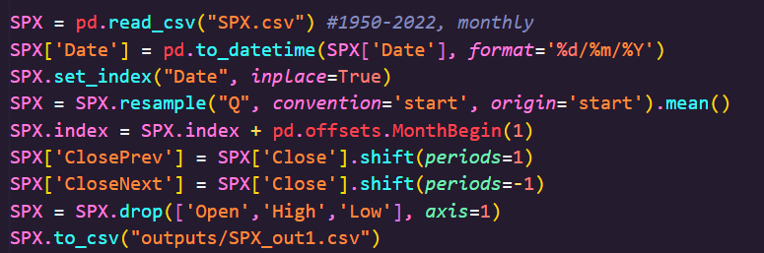
05
Data Preparation
Concat dataframes, Drop Null Values, Resample Data, Format Datetime, Shift Rows, Concat Dataframes, Reset Indexes, Remove Outliers
Notes:
Moving on to Data Preparation, we started off by combining all the 13 economic indicators that we have scraped from the FRED website into 1 single data frame and drop all the rows with null values. For the S&P500 data (here we are calling it SPX), we had to resample it because it is a monthly data whereas many of FRED’s data is quarterly. Some of the other data cleaning steps that we have done include reformatting Datetime, shifting rows, concatenating both data frames, reset indexes and remove outliers.
#####################
say wtv we did to format the data for our models

Slide 6
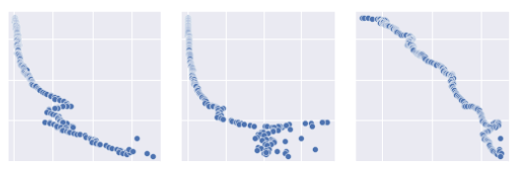
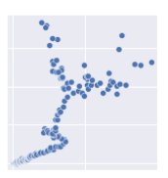
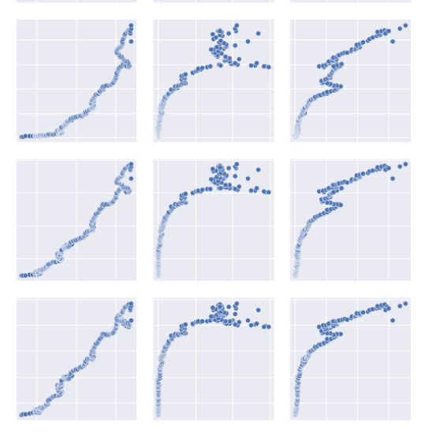
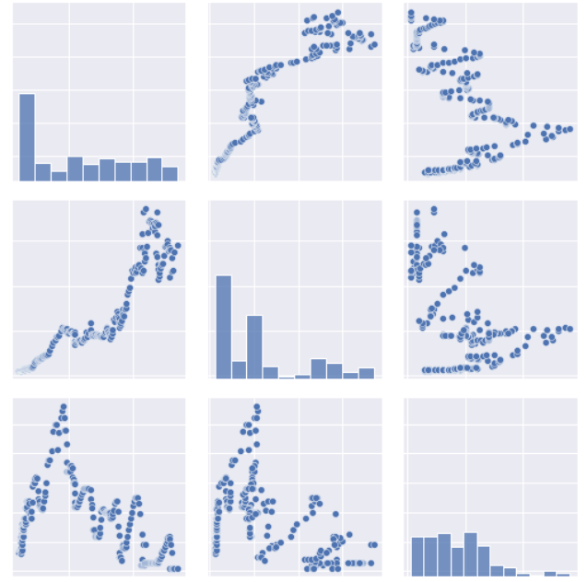
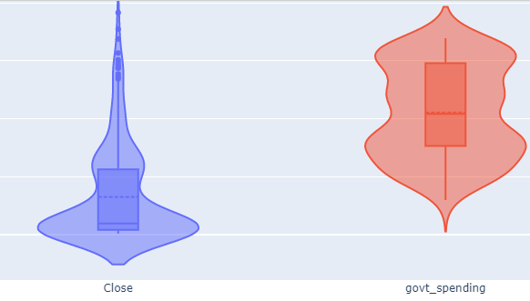
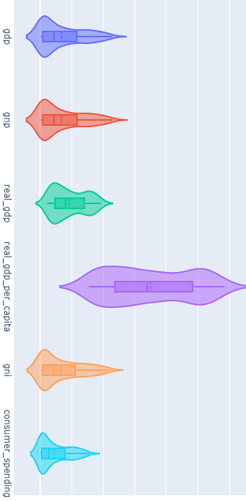
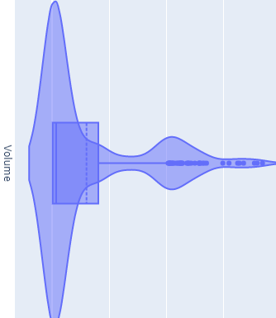
06
Exploratory
Analysis
Violin plots and pair plots
Notes:
For our exploratory analysis, we plotted a few graphs like violin plots and pair plots on each of the economic variables and SPX data. From the violin plots, we can see that most of the data are not normally distributed while there is a huge difference in distribution ‘shape’ among most of the data, a reflection of the stock market’s volatility.
#####################
We ran a few EDAs like boxplots and pairplots.
The pairplots gave us very interesting patterns as seen here.

Slide 7
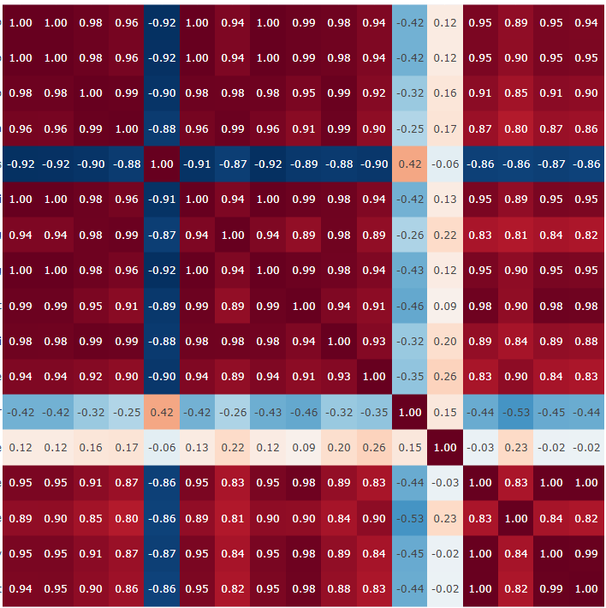

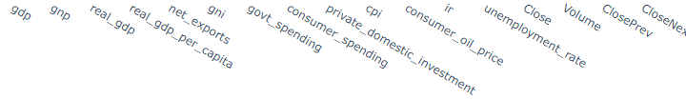
06
Exploratory
Analysis
Correlation matrix
Notes:
When we plotted a correlation matrix on the data, we realised that there seems to be a lot of variables which are highly correlated to one another. Since we are dealing with time series data, this could be a sign of ‘trend’ and not genuine correlation.
#####################
But what caught our eye was the correlation matrix, lots of these variables are very highly correlated to one another. Almost too good to be true
So this could be an issue of trend (explain)

Slide 8
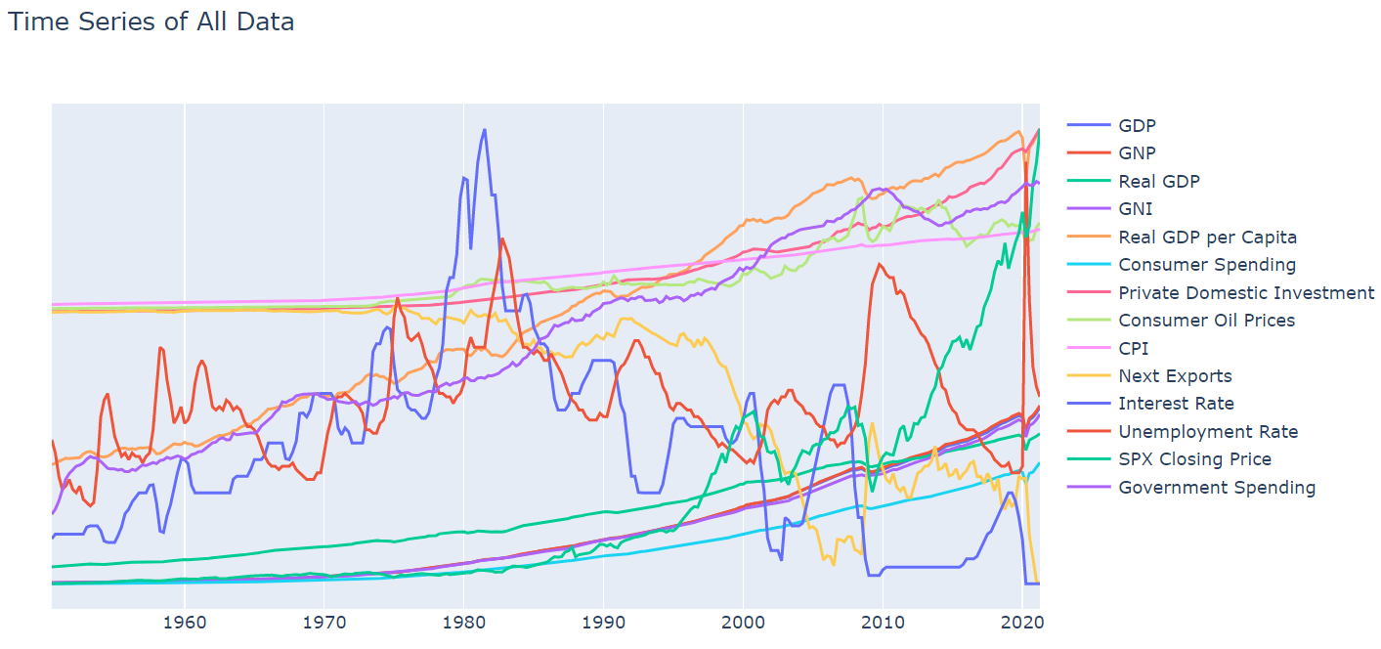
Exploratory
Analysis
06
Correlation matrix
Notes:
By plotting a line plot on all the time series data, the underlying ‘trend’ can be observed quite clearly as we can see that most of the lines have a smooth upward curve.
#####################
After looking at the whole time series graph, we realise that trend was indeed an issue

Slide 9
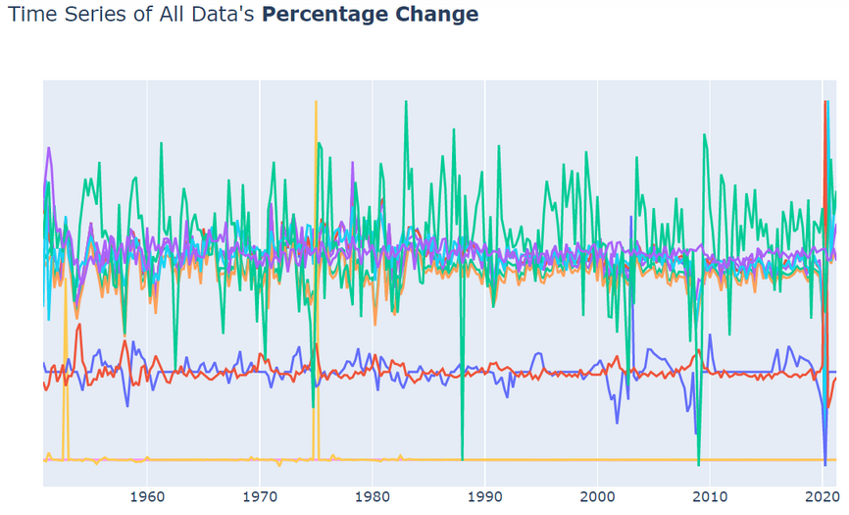
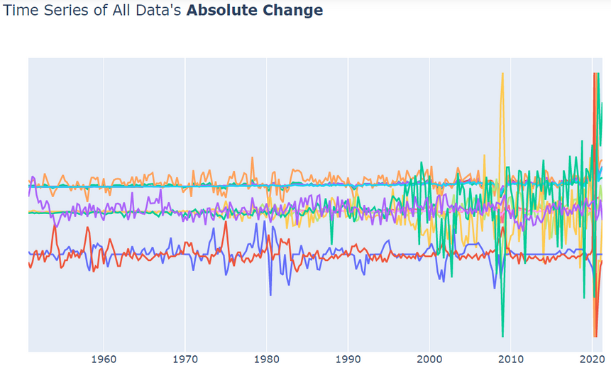
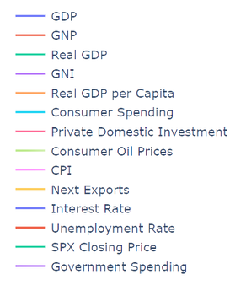
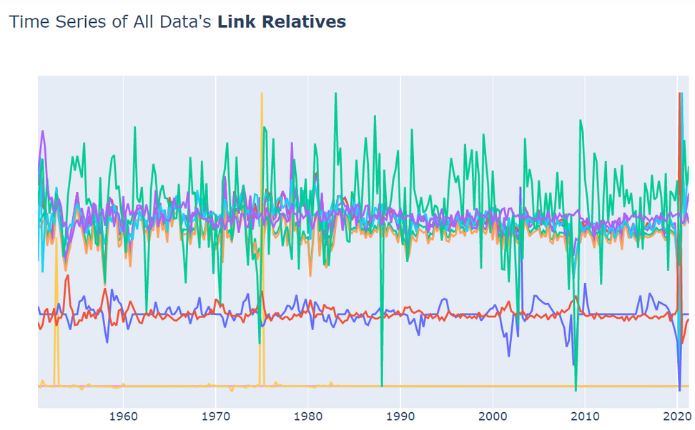
07
Analytic
Visualisation
De-trend data
remove the effects of trend from a data set to show only the differences in values from the trend
allows patterns to be identified
Notes:
To ‘de-trend’ the data, we used 3 different methods, which are Absolute Change, Percentage Difference and Link Relatives respectively. After detrending, we can see how different the time series line plot becomes as we are now looking at the differences in values from one period of time to the next.
#####################
state the 3 ways we detrended our data
Here you can see just how different the time series becomes when we're looking at absolute difference

Slide 10
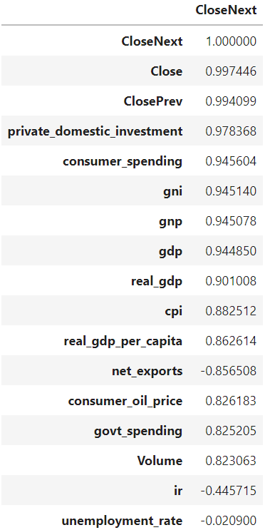
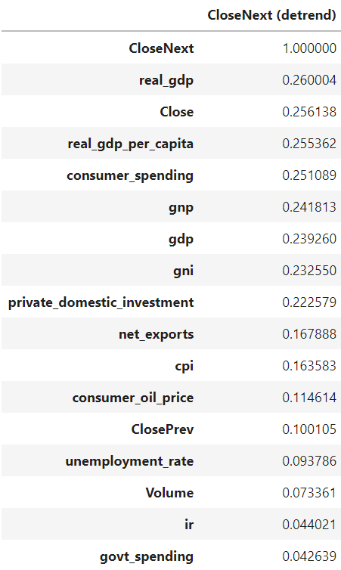
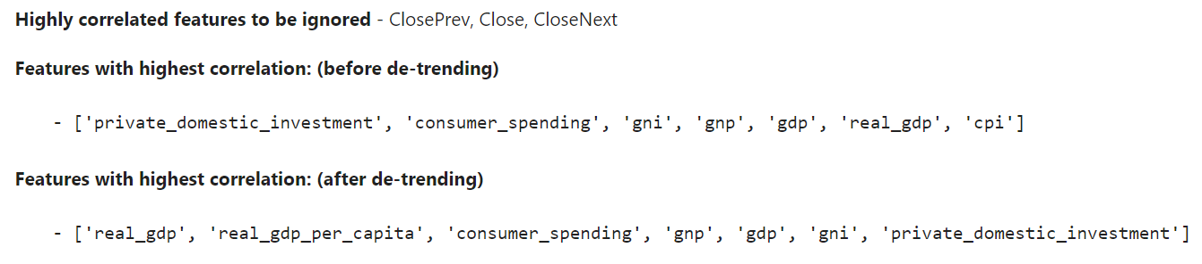
07
Analytic
Visualisation
Correlations before & after de-trending
Notes:
From these 2 charts here, we can also see how much the correlation between the economic indicators (which are our predictors) and closing price of SPX (which is the value to be predicted) has decreased after de-trending the data. Had we not detrended the data, we could have been misleaded into selecting more weakly correlated indicators for predicting the SPX price which would greatly reduce the accuracy of our predictive model.
#####################
Show how correlations and their rankings vary before and after detrending - importance of detrending

Slide 11

08a
Machine Learning I
Multiple Polynomial Regression
1. select features
Notes:
Now we will be moving on to the interesting part, which is Machine Learning. To predict SPX prices using economic indicators, we have selected Multiple Polynomial Regression as our candidate for the task. We choose Multiple Polynomial Regression because it accepts multiple predictors (which is what we want since we have multiple econ indicators), and is also more accurate than Linear Regression when the relationship between the data is non-linear, which is the case with most real-life situations. By focusing on post-detrend indicators with high correlation, we ran the model several times with different combinations of these features and found that the most reliable results are achieved with these 5 features which can be seen on the screen here.
#####################
By focusing on these top-correlated features, we ran the model several times with different combinations of these features, and found that the most reliable results are achieved with these 5 features.

Slide 12
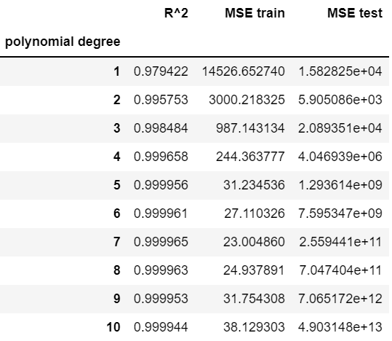
08a
Machine Learning I
Multiple Polynomial Regression
2. select polynomial degree
Notes:
For polynomial degree, the lowest Mean Squared Error, or MSE, (from test set) is achieved at polynomial degree 2.
Beyond degree 2, we see overfitting

Slide 13
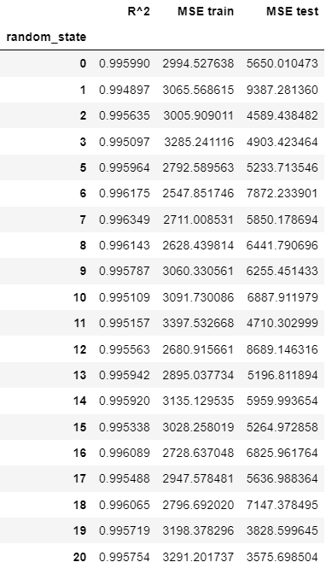
08a
Machine Learning I
Multiple Polynomial Regression
3. collect MSEs of 1001 runs
4. remove outliers
Notes:
In order to get an accurate estimate of the accuracy of our regression model, we ran the model 1001 times, collected MSEs of 1001 runs and removed outliers.

Slide 14
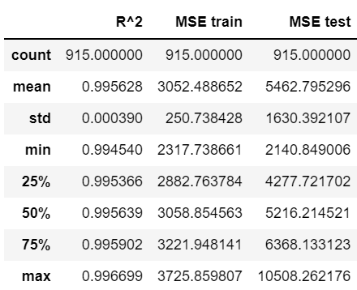
08a
Machine Learning I
Multiple Polynomial Regression
5. statistical description
Notes:
This is the statistical description of the remaining 915 runs.

Slide 15
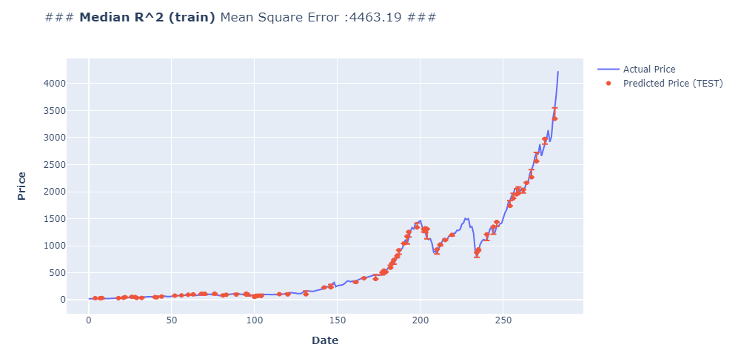
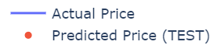
Multiple Polynomial Regression
Visualised Results (with median R^2)
Notes:
Here you see our test set results from the train-test-split with median train R^2.

Slide 16
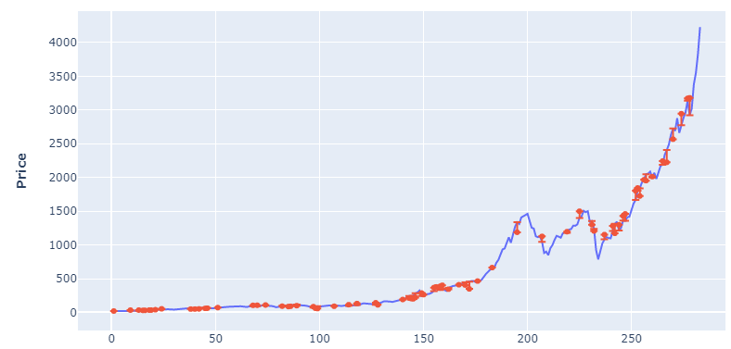

Multiple Polynomial Regression
Visualised Results (with median MSE)
Notes:
Here you see our test set results from the train-test-split with median train MSE.

Slide 17
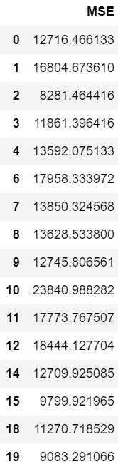
08b
Machine Learning II
Long Short-Term
Memory (LSTM)
1. collect MSEs of 20 runs
2. remove outliers
Notes:
Now we will begin to see the performance of our LSTM model. We ran our LSTM model 20 times, collected the MSE of each run and removed 4 outliers. The reason why we only ran it 20 times is because LSTM is a Recurrent Neural Network which takes time to train. For our case, each LSTM run took us 2 mins whereas it only took us 15s to run our regression model 1001 times.

Slide 18
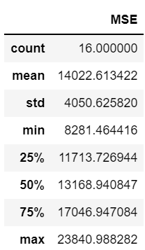
08b
Machine Learning II
Long Short-Term
Memory (LSTM)
3. statistical description
Notes:
Here is the statistical description of the remaining 16 runs.

Slide 19
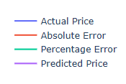
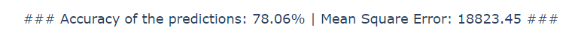
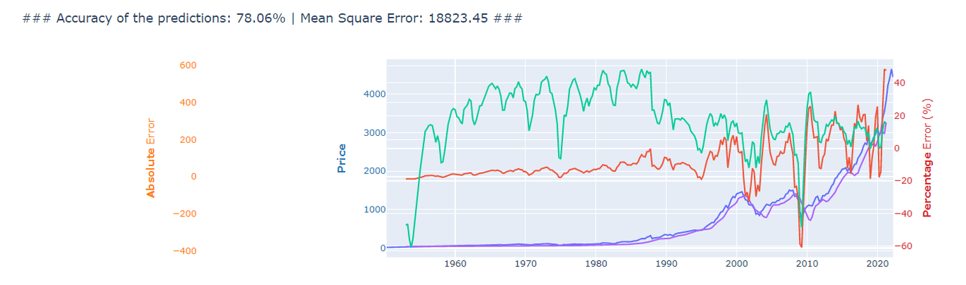
Long Short-Term Memory (LSTM)
Visualised Results
Notes:
These are the results of our LSTM model. If you look closely the graph has 2 y-axes: The Absolute Error axis corresponds to the green and orange lines whereas the Price axis corresponds to the blue and purple lines.

Slide 20
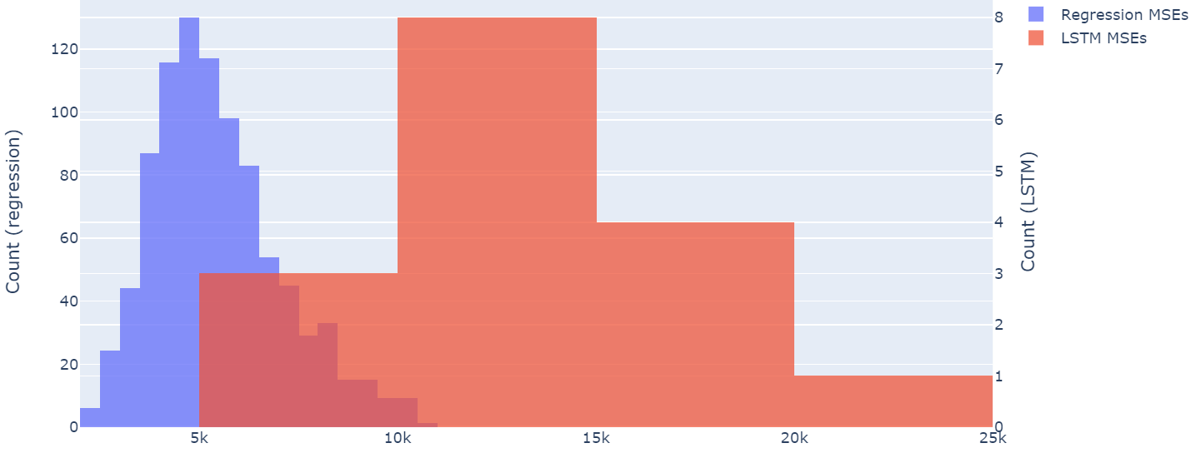

09
Statistical
Inference
Median Comparison
Regression's MSE is 65.5% less than LSTM's
Notes:
Now, after all these you may wonder how does the LSTM model compare to the Regression Model? It turns out that the Regression's MSE is a whopping 65.5% lesser than LSTM's.

Slide 21
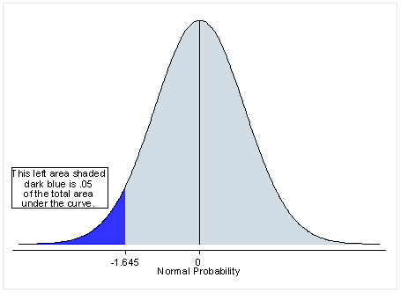
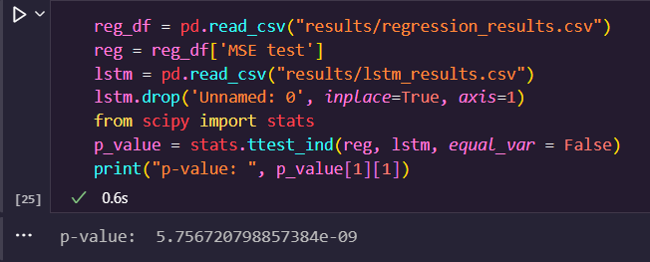
09
Statistical
Inference
Hypothesis Testing:
h0= "Both MSEs are equal",
h1= "Reg's is lower than LSTM"
Reject h0 at 1%
significance level
Notes:
To further test our findings, we decided to do a hypothesis test to test the claim that “Regression’s mean MSE is lower than LSTM” at the 1% significance level. The test that we have selected is Welch’s T-test because both samples have different sizes and variances. After running the Python code, we can see that the p-value of the test statistic is around 5.8x10^-9, which falls in the critical region. Hence, we conclude that the null hypothesis is rejected at a 1% significance level and there is sufficient evidence to claim that Regression’s mean MSE is lower than LSTM.

Slide 22

10
Intelligent Decision
Regression model performs much better than LSTM because it doesn't assume that the past indicates the future.
It puts more emphasis on understanding the relationship between the economic situation & market sentiment to stock prices.
Notes:
In conclusion, it is undoubted that our regression model far outperforms LSTM. So how does this address our formulated problem? We identified a weakness of LSTM - it fully relies on past data to predict the future. But often times, the past is not a good indicator of the future, more so due to the stock market's volatile nature. Our multiple polynomial regression, on the other hand, collects current economic indicators and uses these as an indicator of future performance, which turned out to achieve much better results. This is because by understanding the relationship between econ indicators and stock market price, our regression model is able to take into account external factors like the econ situation and market sentiment of a country, which impacts stock market performance much more than past trends.

Slide 23
Recommendations
Use both past trends and current economic situations as predictors
Try weekly/daily data instead of quarterly/monthly data
Try testing model on different on other index funds or stocks
Use market sentiment indicators - convert news headlines to measurable parameters
Use simpler models whenever possible eg. LSTM vs regression
Always de-trend
Select only top-most correlated ones to prevent overfitting
Notes:
To wrap things up, these are our recommendations:
1) Based on these insights (from previous slide), we recommend designing a predictive model that takes both past trends and current economic situations as predictors
2) Try using weekly/daily data instead of quarterly/monthly data for more precise results, in other words quarterly/monthly data (e.g. GDP) can be converted to weekly/daily data by repeating the same values within the same quarter/month.
3) Can also try testing model on other index funds or stocks to see how versatile is it.
4) Bring in market sentiment indicators such as NLP tools that scrapes and convert news headlines to measurable market/economic parameters
5) Use a simpler model whenever possible as it takes less time and resources which means we are able to run more test models. Being able to run more tests allows us to better assess and refine models.
6) Always de-trend to ensure correlation is not a result of general trend
7) Select only top-most correlated features to avoid overfitting

Slide 24
Thank You! :)

